Slide 1
Research Methodology & IPR (R1UC701T)
By : Dr. Ruby Dahiya

Slide 2
Opening Question
What do you think is a research problem
and
Why is it important in the context of academic research?

Slide 3
What is Research?
Research can be defined as the search for knowledge or as any systematic investigation to establish facts.
The Advanced Learner’s Dictionary of Current English lays down the meaning of research as “a careful investigation or inquiry specially through search for new facts in any branch of knowledge”.
In short, the search for knowledge through objective and systematic method of finding solution to a problem is research.

Slide 4
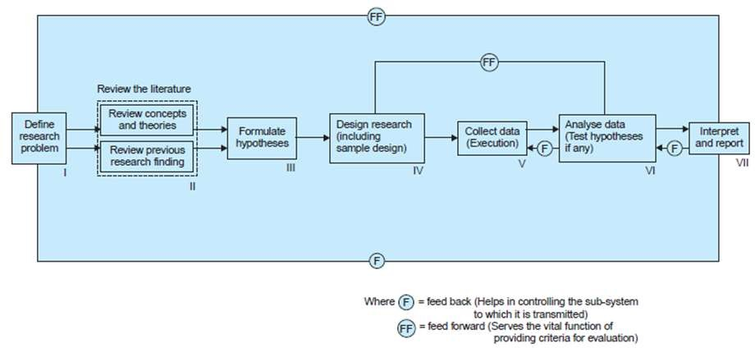
Research Process Flow Chart

Slide 5
Research Process Stages
Formulating the research problem
Extensive literature survey
Developing the hypothesis
Preparing the research design
Determining sample design
Collecting the data
Execution of the project
Analysis of data
Hypothesis testing
Generalization and interpretation
Preparation of the report or presentation of the results, i.e. formal write-up of conclusions reached.

Slide 6
Research Problem
In research process, the first and foremost step happens to be that of selecting and properly defining a research problem.
To define a problem correctly, a researcher must know: what a problem is.
A research problem, in general, refers to some difficulty which a researcher experiences in the context of either a theoretical or practical situation and wants to obtain a solution for the same.

Slide 7
Importance of Defining a Research Problem
Guides the Research Process: Helps in formulating research questions, hypotheses, and objectives.
Focus and Clarity: Provides a clear focus for the study, ensuring that the research remains relevant and significant.
Resource Allocation: Efficient use of time, money, and other resources by focusing on a well-defined problem.

Slide 8
Examples
Broad: "How can machine learning be improved?“
Specific: "How can reinforcement learning algorithms be optimized for real-time traffic management?"

Slide 9
Activity 1: Identifying Research Problems
Task: Identify specific research problems within the below mentioned topics in small groups.
Example Topics: "Artificial Intelligence", "Cybersecurity", "Internet of Things (IoT)“………
Possible Research Problems: AI: "How can bias in AI algorithms be reduced?"
Cybersecurity: "What are the vulnerabilities of blockchain technology?"
IoT: "How can energy consumption be minimized in IoT devices?"

Slide 10
Criteria\ Characteristics of Good Research
Systematic
Logical
Empirical
Reductive
Replicable

Slide 11
Problems Encountered by Researchers in India
The lack of a scientific training in the methodology of research
There is insufficient interaction between the university research departments
There is lack of confidence that the information/data obtained will not be misused.
There does not exist a code of conduct for researchers
Difficulty of adequate and timely secretarial assistance
Library management and functioning is not satisfactory at many places
There is also the difficulty of timely availability of published data
The problem of conceptualization

Slide 12
Motivation for Research
Desire to get a good academic profile along with its consequential benefits.
Desire to face the challenge in solving the unsolved problems, i.e., concern over practical problems initiates research.
Desire to get intellectual joy of doing some creative work.
Desire to be of service to society.
Desire to get respectability.

Slide 13
Components of Research Problem
There must be an individual or a group which has some difficulty or the problem.
There must be some objective(s) to be attained at. If one wants nothing, one cannot have a problem.
There must be alternative means (or the courses of action) for obtaining the objective(s) one wishes to attain. This means that there must be at least two means available to a researcher for if he has no choice of means, he cannot have a problem.

Slide 14
Components of Research Problem (contd.)
There must remain some doubt in the mind of a researcher with regard to the selection of alternatives. This means that research must answer the question concerning the relative efficiency of the possible alternatives.
There must be some environment(s) to which the difficulty pertains

